Slide 1
IT1102
Computer Hardware
Week 8 - 9
PC Internal Components And the Structure

Slide 2
Modular Design
Approach that subdivides a system into smaller parts (modules) that can be independently created
Advantages
  Flexible structure
  Easy to maintain
  Easy to upgrade
  Customizable
  Changing customer requirements

Slide 3
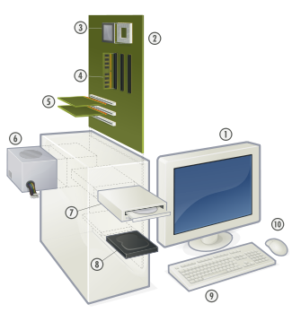
PC Modules
1. Monitor
2. Motherboard
3. CPU
4. RAM
5. Expansion cards
6. Power supply
7. Optical discs drive
8. Hard disk drive
9. Keyboard
10. Mouse

Slide 4
Mother Board
Main circuit board
System board, Logic board, Baseboard
All other components are connected
Powered by Power supply
Connectors
Determines expansion capability

Slide 5
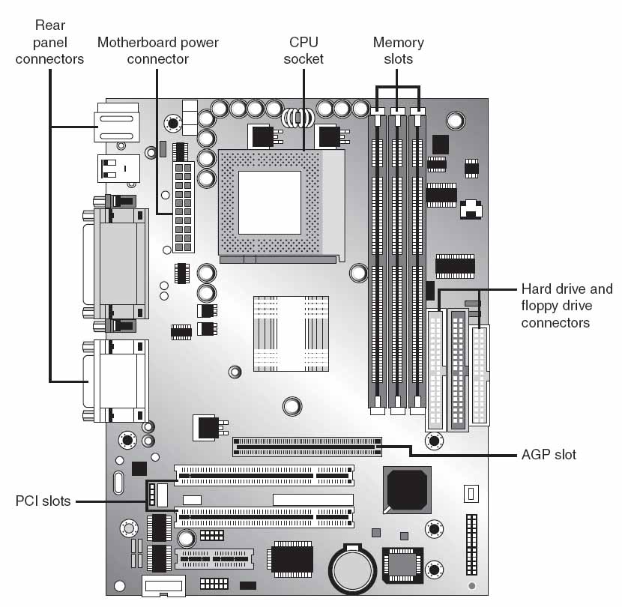

Slide 6
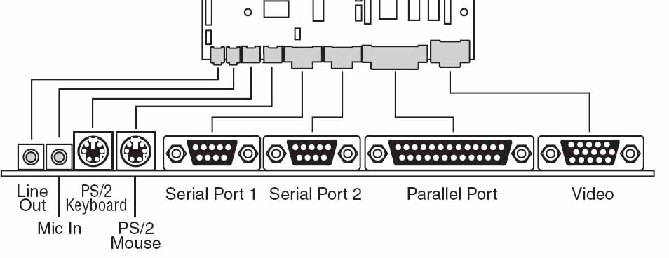
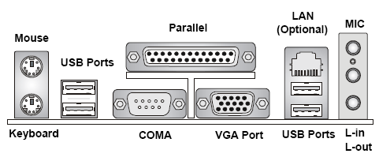
Motherboard
Back panel I/O Connectors

Slide 7
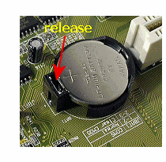
CMOS Battery
Complementary Metal Oxide Semiconductor
On-board battery to power semiconductor chip
Battery help to retain system settings, date, and time when the computer is turned off

Slide 8
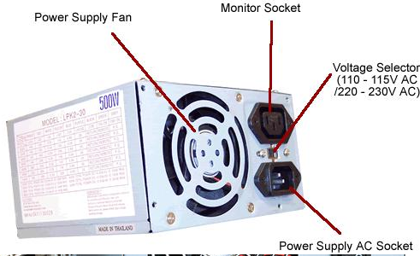
Power Supply
A power supply unit (PSU) converts mains AC to low-voltage regulated DC power for the internal components of a computer
Most of modern are ATX

Slide 9
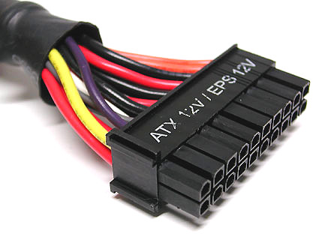
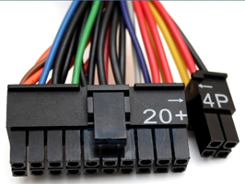
Power Supply Connectors
Use to connect the power supply with mother board and other component
  ATX style connector
    Power supply to mother board
    20 pin or 24 pin
  ATX-2
    The extra 4 pins
    To power a PCI-E graphics card.

Slide 10
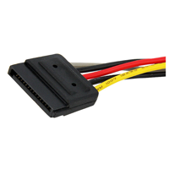
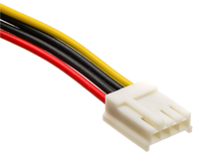
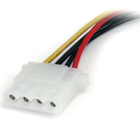
Power Supply Connectors
  SATA power connectors
  4-pin Floppy
  Hard drive / CD/DVD power connectors

Slide 11
CPU
Central processing unit (CPU) is the electronic circuitry within a computer that carries out the instructions of a computer program by performing the basic arithmetic, logical, control and input/output (I/O) operations specified by the instructions.

Slide 12
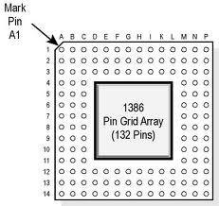
CPU Socket
Connector on the motherboard that houses a CPU
  Pin Grid Array (PGA)
    Flat
    Rectangle
    Grid of pins

Slide 13
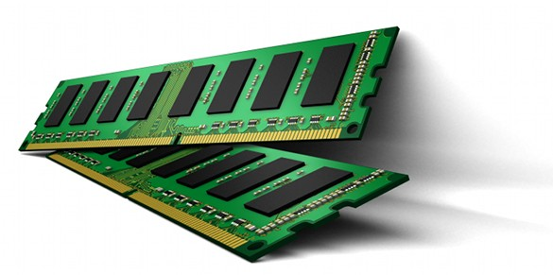
RAM
Random Access Memory (RAM) is a form of computer data storage
Volatile
Primary or main memory

Slide 15
Hard Disk Drives
Hard Disk / CD/ DVD
  IDE
    Integrated Drive Electronics
    Standard electronic interface used between a computer motherboard's bus and the computer's disk storage devices.
    Based on the IBM PC Industry Standard Architecture (ISA) 16-bit bus standard, but also used in computers that use other bus standards.
    ATA (Advanced Technology Attachment)
  SATA
    Serial Advanced Technology Attachment

Slide 16
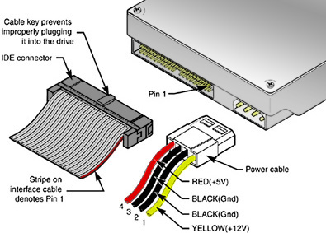
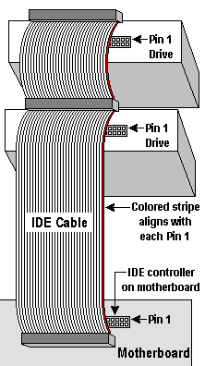
Connecting IDE
Interface
  IDE
  ATA (Advanced Technology Attachment)
Ribbon Cable
  40-pin ribbon cable
    16-bit parallel data transfer
    Two drives

Slide 17
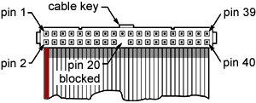
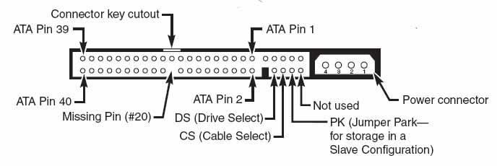
Connecting IDE
IDE interface
  Support two drives
  Master / Slave
  Limited storage of 528 MB

Slide 18
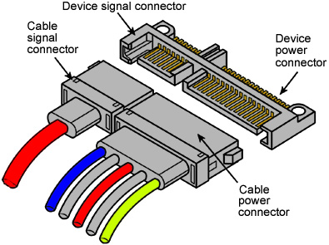
Connecting SATA
SATA
  Lower signal voltage
  Faster signaling
  Backward-compatible with ATA
  SATA 150 MBps
  SATA-2 300 MBps

Slide 19
Form Factors
Size, shape, and screw placement on a motherboard
PC/XT
    First standard
    Introduced by IBM
    Extended Technology (XT)
    Followed by clones
PC/AT
    Introduced by IBM
    Technology improvements
    More smaller components
    Smaller power supply
    Better cooling
    13.5" X 12"

Slide 20
Form Factors
  Baby AT
    By Intel
    Technology improvements
    Smaller components
    IDE
    13" X 8.5 or 9"
  ATX
    Advanced Technology eXtended
    Pentium MMX
    Rear panel hardwired directly to the motherboard
    Power switch connected to motherboard
  Mini ATX
  Micro ATX

Slide 21
Expandability
Most modern ATX motherboards have a maximum of seven PCI or PCI-Express expansion slots, which used to fix additional circuitries

Slide 22
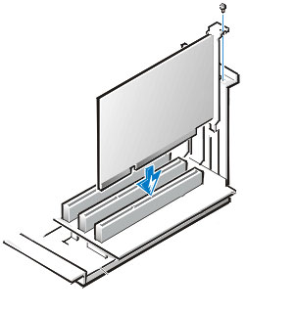
Expansion Cards
Printed circuit board that can be fixed into motherboard for additional capabilities
Sound card, VGA card, Network card,

Slide 23
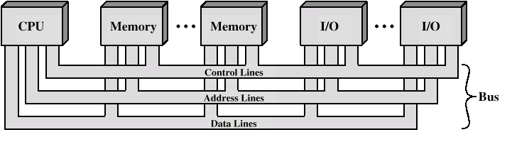
Bus
Communication pathway that connect components on the motherboard
Functional classification
  Data bus
  Address bus
  Control bus

Slide 24
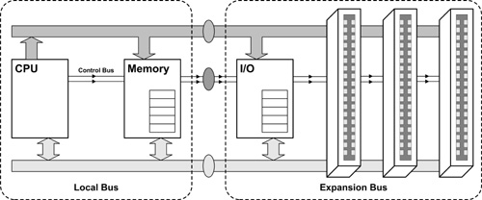
Bus

Slide 25
Types of Bus
ISA - Industry Standard Architecture
  Originally 8 bit, later 16 bit
  Introduced by IBM in 1984, later used by IBM clones
MCA - Micro Channel architecture
  1987 by IBM
  16 bit or 32-bit
EISA – Extended Industry Standard Architecture
  Introduced by IBM clones 1988
  32 bit
  PCI – Peripheral Component Interconnect
  Introduced in 1992
  32 bit or 64 bit

Slide 26
Types of Bus
AGP - Advanced Graphic Port
  Introduced by Intel in 1997 for the high demands of 3-D graphics
  32-bit or 64-bit
  Only for video or graphics
PCI-X - Peripheral Component Interconnect eXtended
  1998
  64 bit
  Backward compatible with 32 bit PCI
PCIe - Peripheral Component Interconnect Express
  2004

Slide 27
Motherboard Chip Set
Chipset is a set of electronic components in an Motherboard that manages the data flow between the processor, memory and peripherals.
North Bridge - Memory Controller Hub
  Connected directly to the CPU via the front side bus (FSB)
  Connect system memory and video output
South Bridge - I/O Controller Hub
  Connect system clock and I/O devices

Slide 28
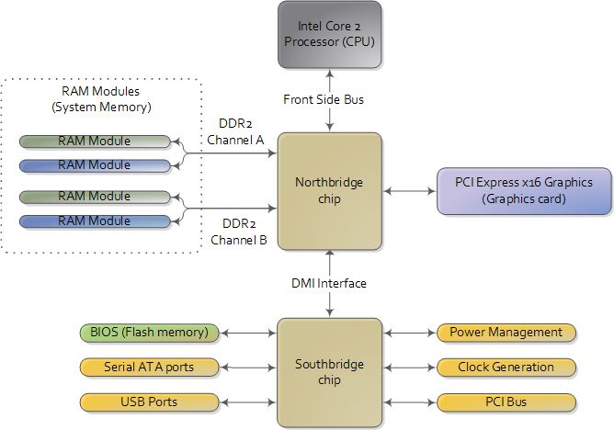
Motherboard Chipset & Memory

Slide 29
Motherboard Chipset & Memory
Front Side Bus (FSB)
  Processor and North bridge
    System memory
    VGA
Back Side Bus
  Processor and the Level 2 cache
  Same speed as processor

Slide 30
Bus Mastering
Feature that enables a bus controller (chip set) to communicate directly with other devices on the bus without going through the CPU.

Slide 31
DMA - Direct Memory Access
Method that allows an input/output (I/O) device to send or receive data directly to or from the main memory, bypassing the CPU to speed up memory operations.
The process is managed by a chip known as a DMA controller (DMAC) in motherboard chipset

Slide 32
Traditional Memory Access
Traditional I/O Memory Access
  CPU controls the data transfer between I/O device & main memory
  Slow
  CPU is busy

Slide 33
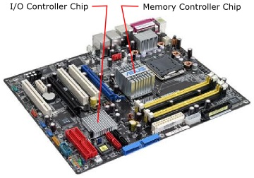
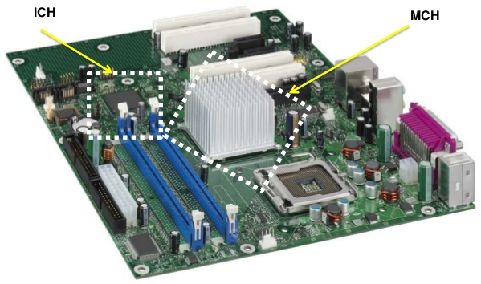

Slide 34
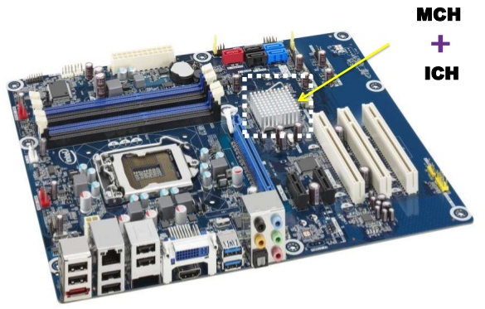

Slide 35
Interrupt Request - IRQ
Signal from a device interface to processor to get attention
Interrupt Request lines
  Special pathways directly to the processor from device interfaces
  Device get the attention of the CPU
Interrupt handler
  System SW
Interrupt controller
  Part of the mother board chipset
  Checks the interrupt information and source before passing it to the CPU

Slide 36
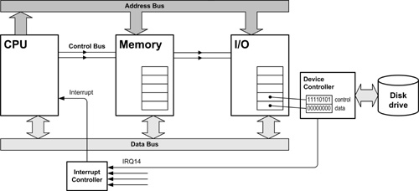
IRQ

